Slide 1
Introduction to Ohio Supercomputer Center Resources
Cankun Wang
Wednesday, July 10, 2024

Slide 2
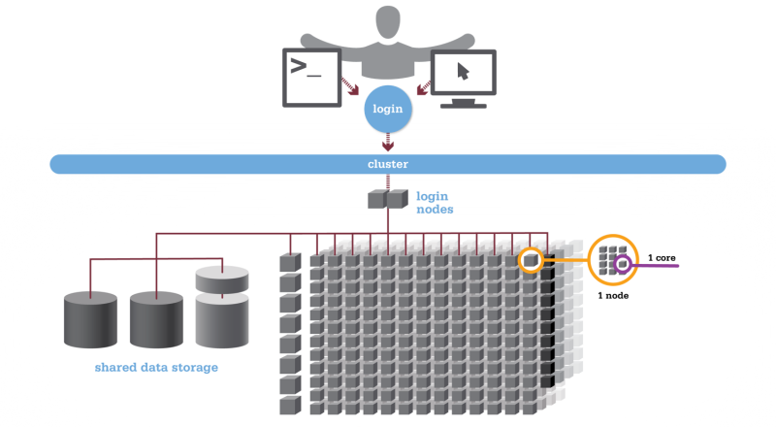
High Performance Computing (HPC)
Aggregated resources to perform computation intensive tasks
Core: processor (single unit)
Node: computer or a server
Cluster: multiple nodes connected
Workflow
connect to login node
submit job to scheduler
wait in queue
batch scheduler will run your job when resources become available

Slide 3
Ohio Supercomputer Center (OSC) Clusters
Pitzer Cluster: A 10,240-core Dell Intel Gold 6148 + 19,104-core Dual Intel Xeon 8268 machine (2018)
Owens Cluster: A 23,392-core Dell Intel Xeon E5-2680 v4 machine (2016)
Ascend Cluster: A 2,304-core Dell AMD EPYC™ machine (2022)
Cardinal Cluster: A 39,312-core, 378 node Dell Intel CPU Max 9470 HBM machine (2024)
GPU Computing: All OSC systems now support GPU Computing. Specific information is given on each cluster's page.
Owens: 160 NVIDIA Tesla P100
Pitzer: 64 NVIDIA Volta V100 (two each on 32 nodes); 84 NVIDIA Volta V100 (two each on 42 nodes); 16 NVIDIA Volta V100s and NVLink (four each on 4 nodes)
Ascend: 96 NVIDIA A100s and NVLink (four each on 24 nodes)
Cardinal: 128 NVIDIA H100s and NVLink (four each on 32 nodes)

Slide 4
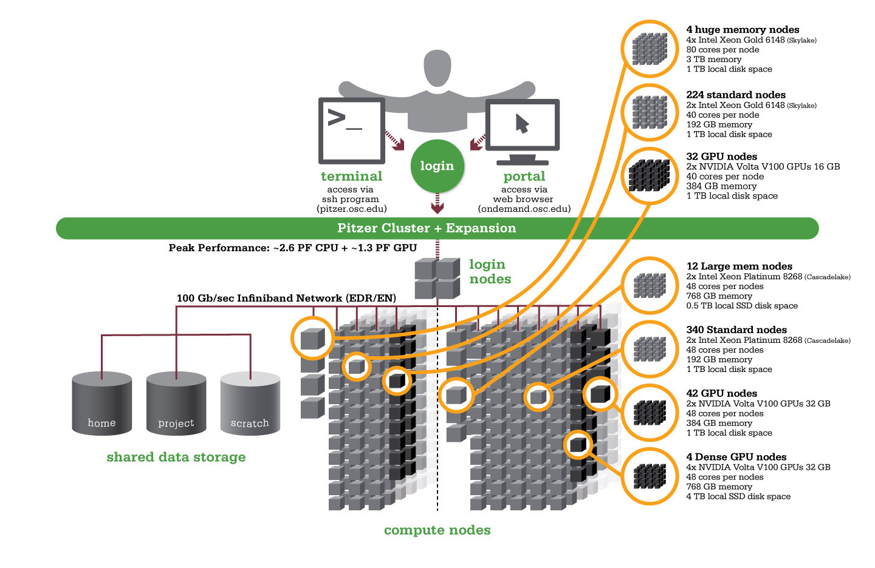
Pitzer Cluster
A 10,240-core Dell Intel 19,104-core machine
Use Pitzer for most of your tasks

Slide 5
Terminology
Login nodes: limited CPU/memory usage, only for edit, download/upload files, manage your jobs for batch scheduling
Compute nodes: for CPU-memory intensive operations, available based on the requirements of the jobs submitted by all users
Scheduler: allows us to submit jobs that request the resources needed, in terms of nodes, CPUs memory and GPUs.
Jobs are queued and run when the requested resources become available

Slide 6
OSC On Demand
Access OSC HPC resources through a web browser
No need to install/ configure client software
Things you can do:
Upload/ download files
Create/edit/submit or monitor jobs
Run GUI applications
Connect via SSH – for command line access
https://ondemand.osc.edu/

Slide 7
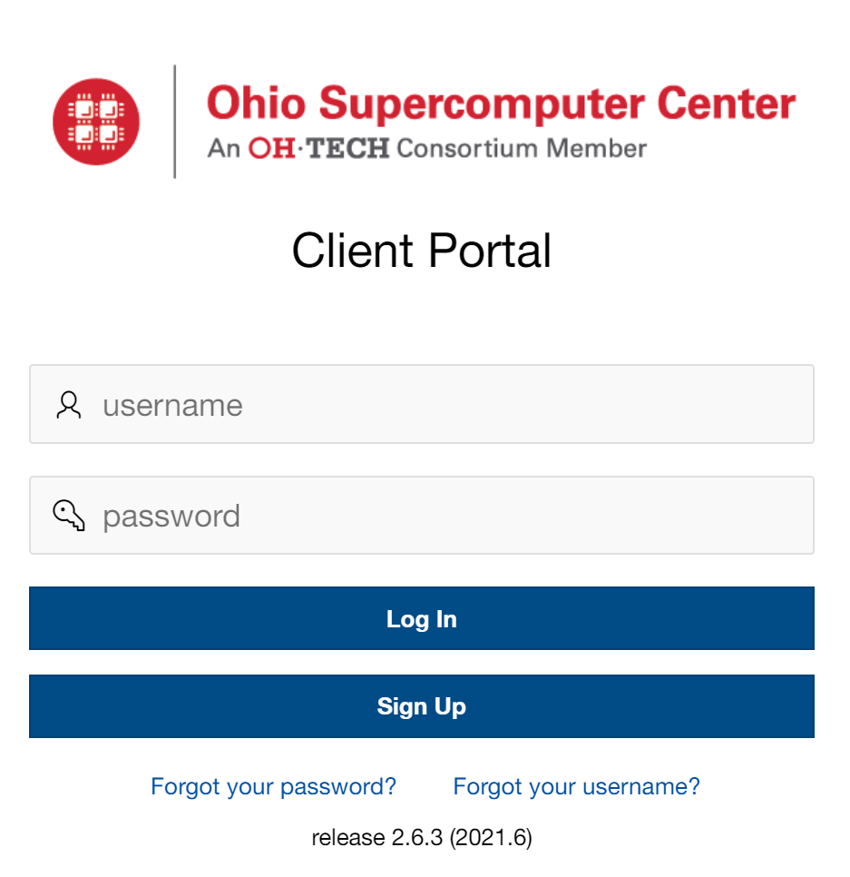
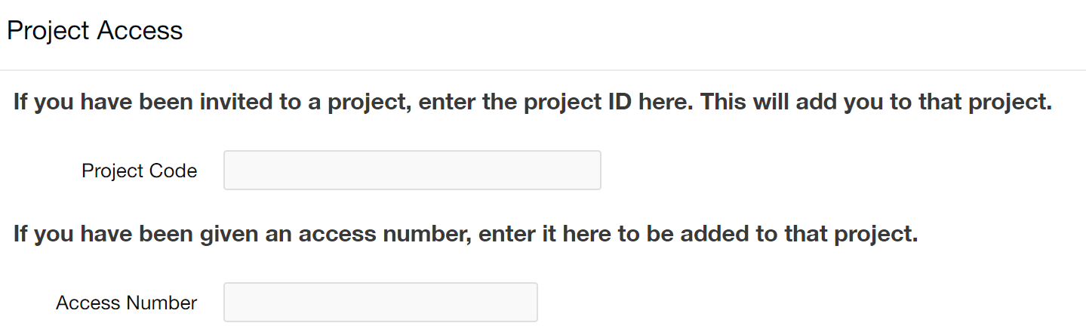
OSC – sign up
https://my.osc.edu/
Project code: XXX

Slide 8
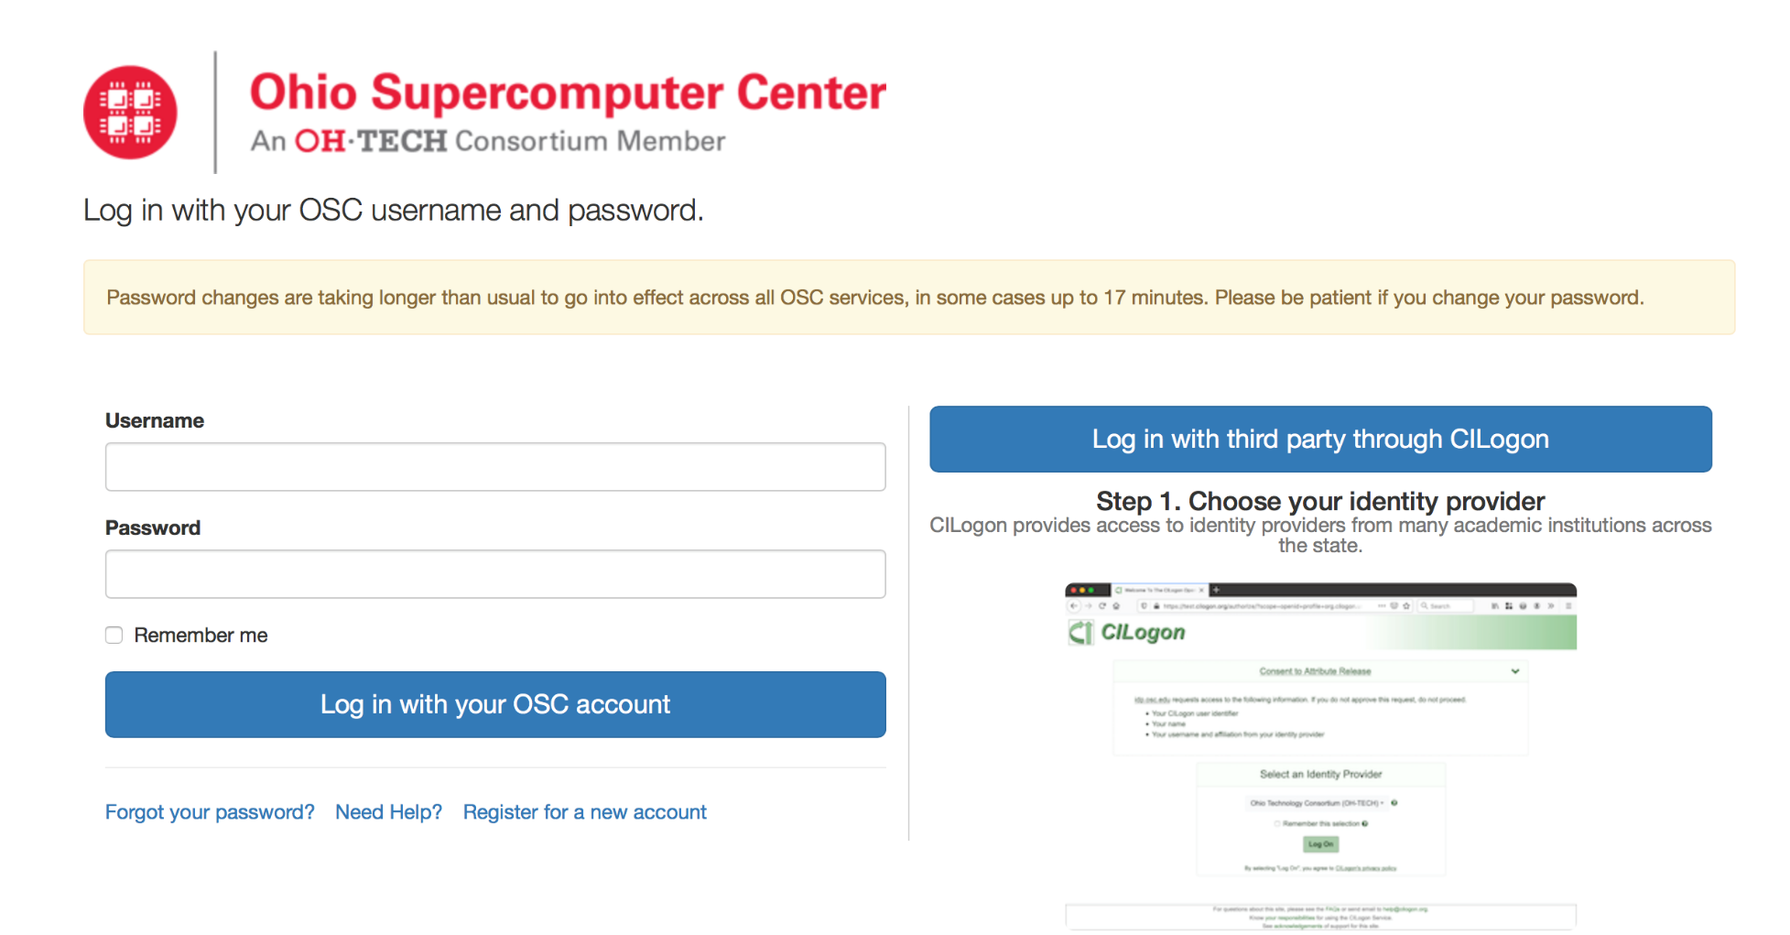
Login to OSC - OSC on Demand
https://ondemand.osc.edu

Slide 9
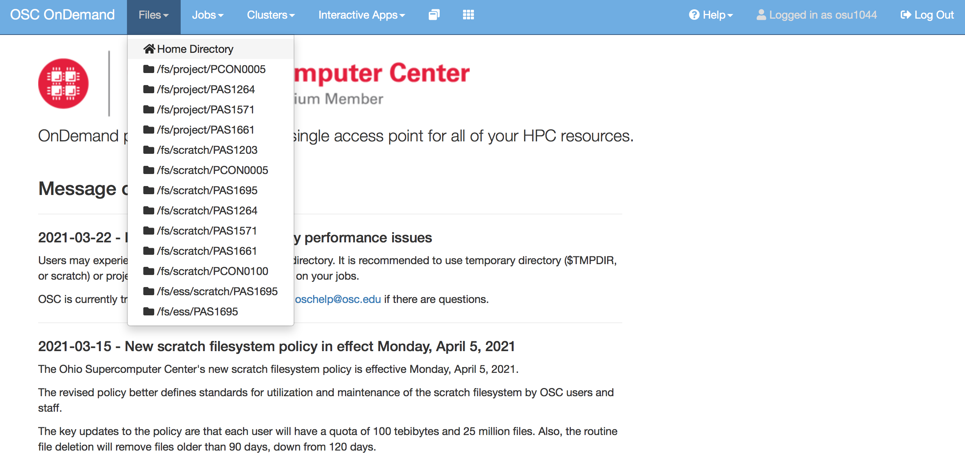
OSC File management
Home directory: 500GB private storage, 1 million files
/fs/ess: Permanent storage, shared 1 million files
/fs/scratch: Temporary and unlimited storage, files will be deleted after 3 months!!!!!

Slide 10
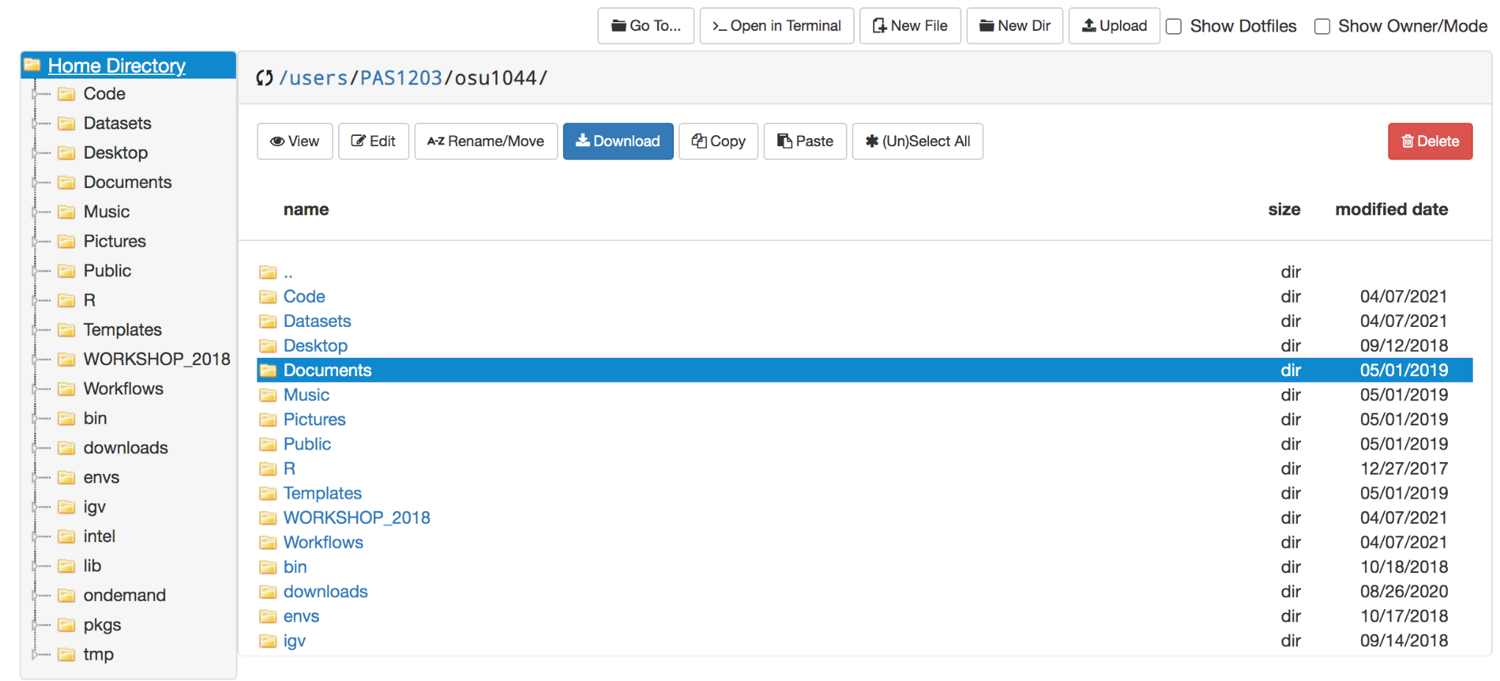
OSC File management – navigation
123

Slide 11
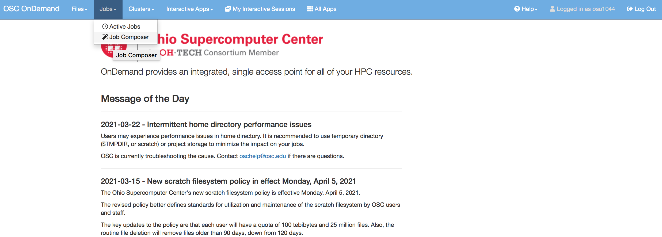
OSC Job management
123

Slide 12
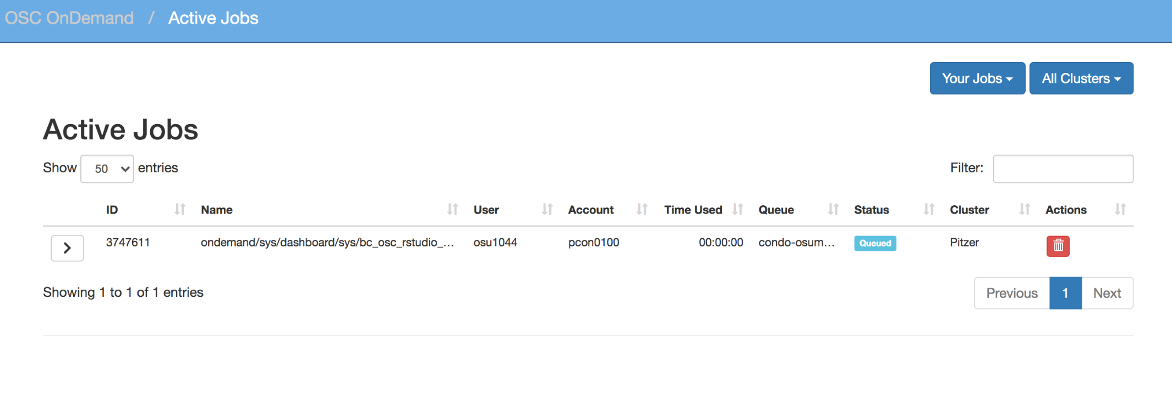
OSC Job management – Active jobs
123

Slide 13
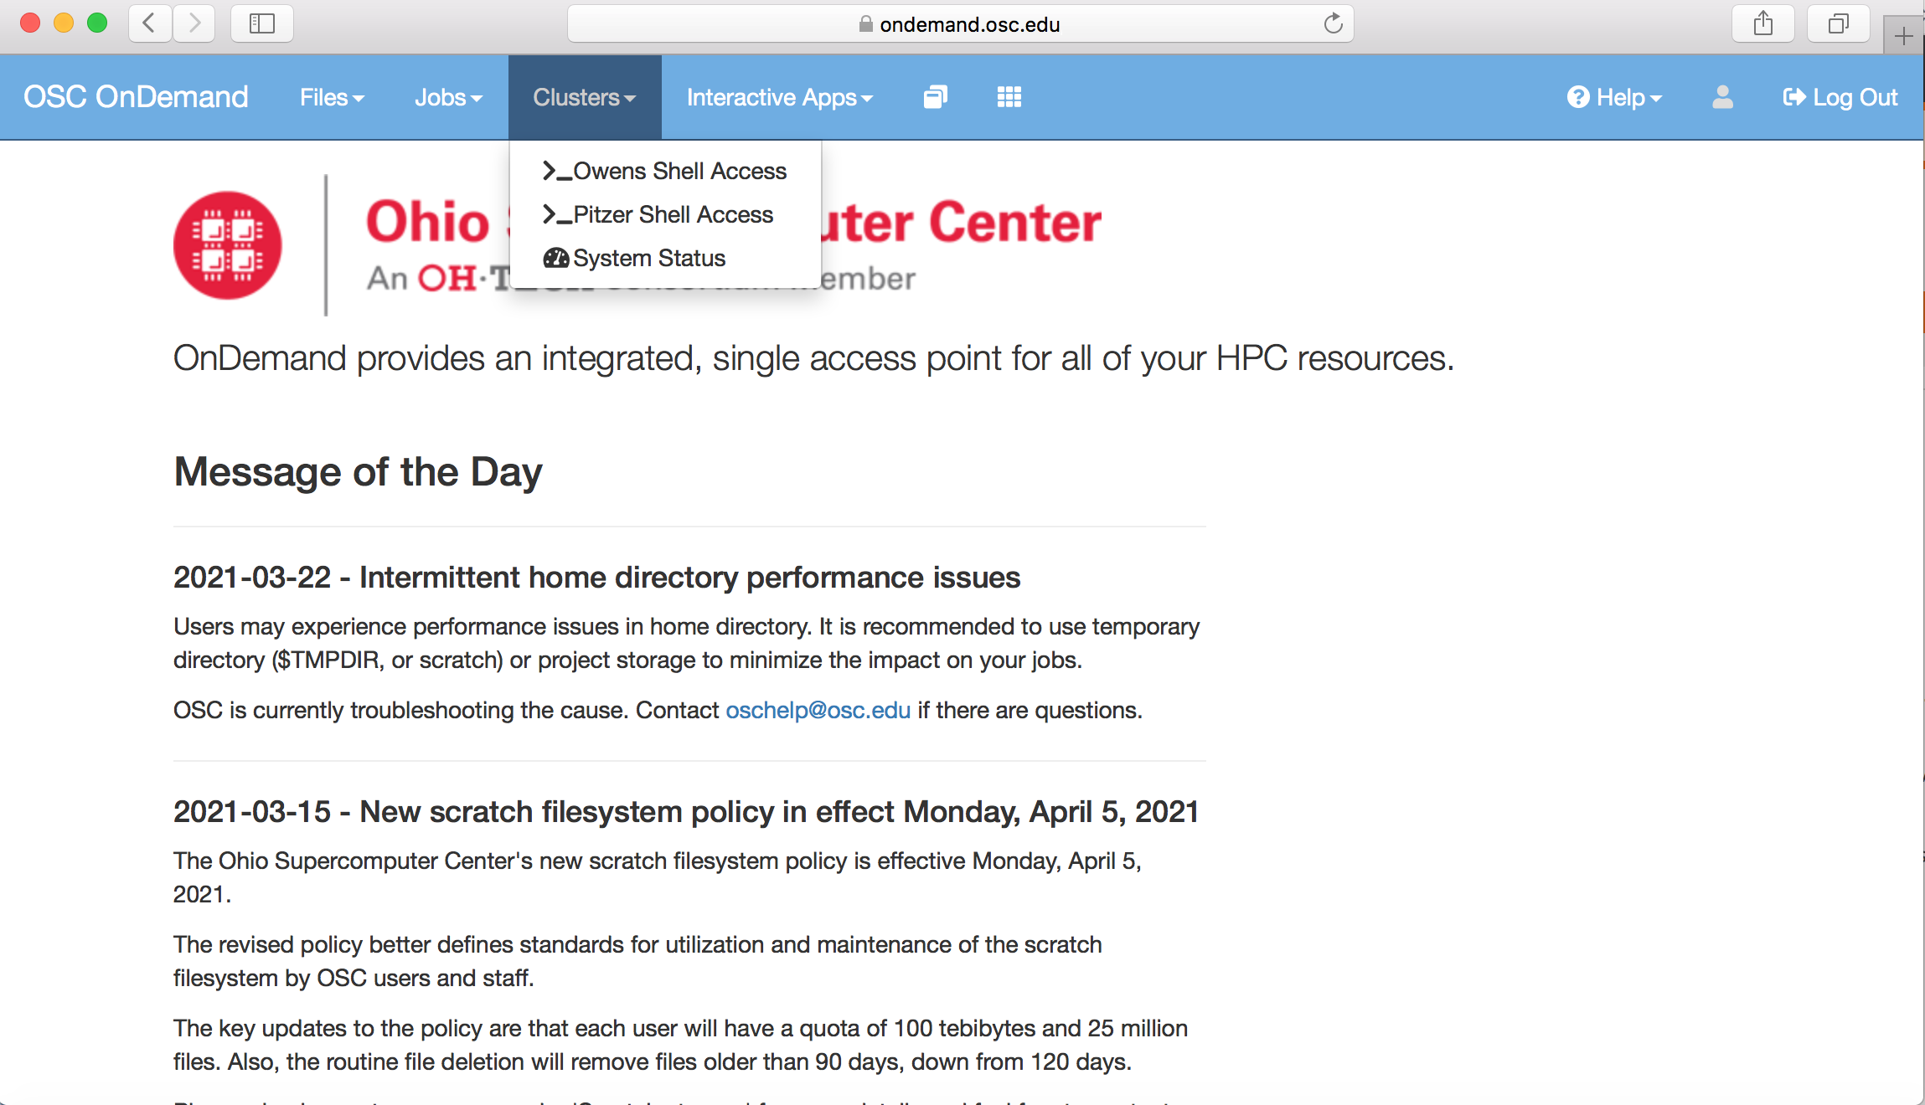
OSC OnDemand Shell Access
Owens is retired, Just use Pitzer

Slide 14
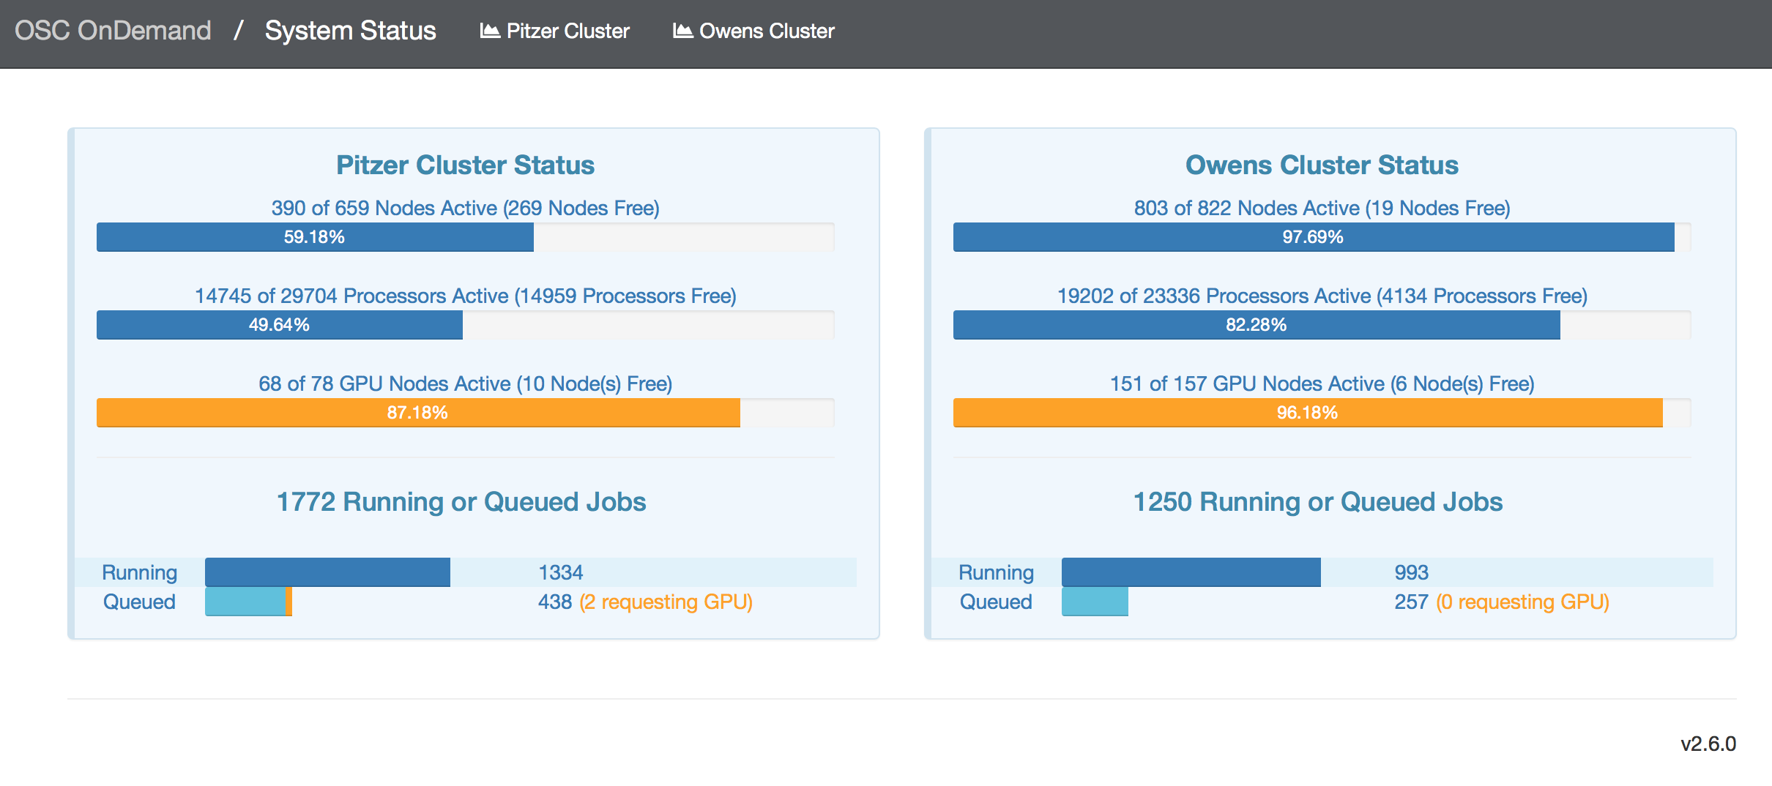
OSC OnDemand system status
123
Nodes/cores in use and number of running/queued jobs
Click on each cluster to get more detailed report like system load, CPU, memory usage, network load

Slide 15
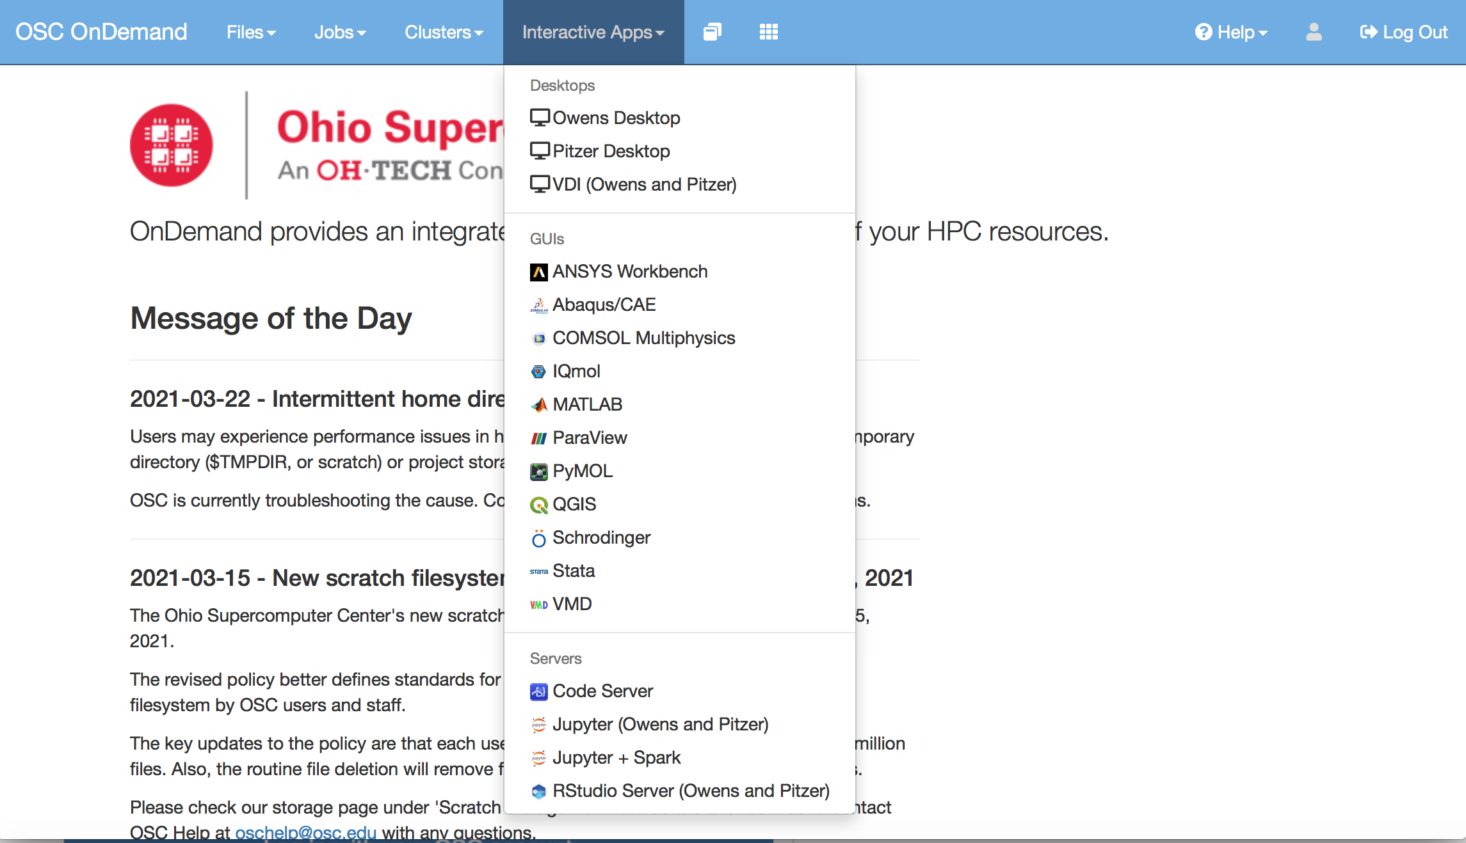
OSC On Demand- Interactive apps
123

Slide 16
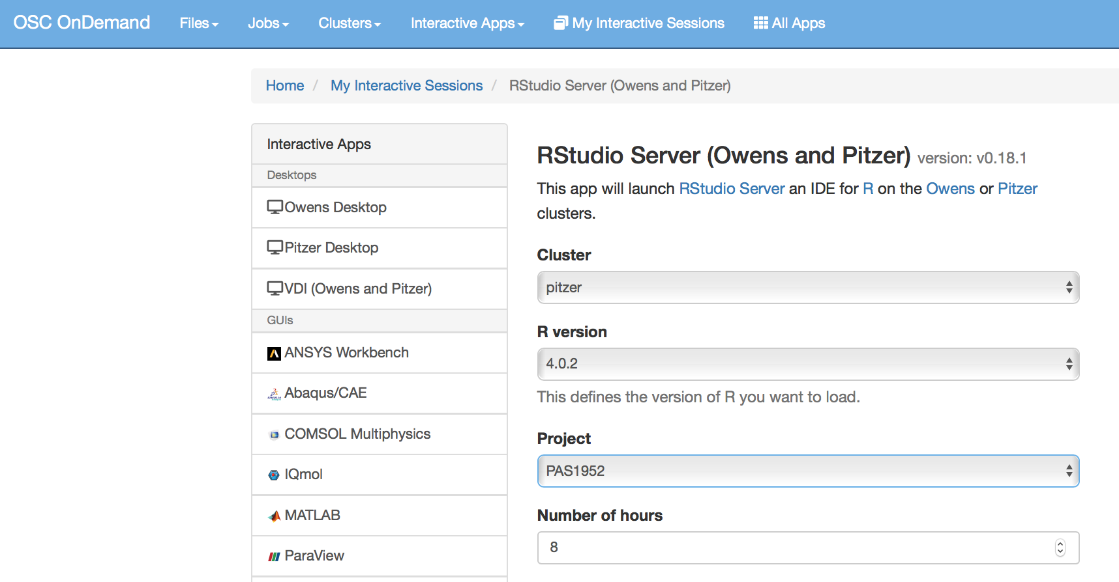
OSC OnDemand - Rstudio Server
Select cluster
Select latest R Version
Define Project ID
How long do you need resources?

Slide 17
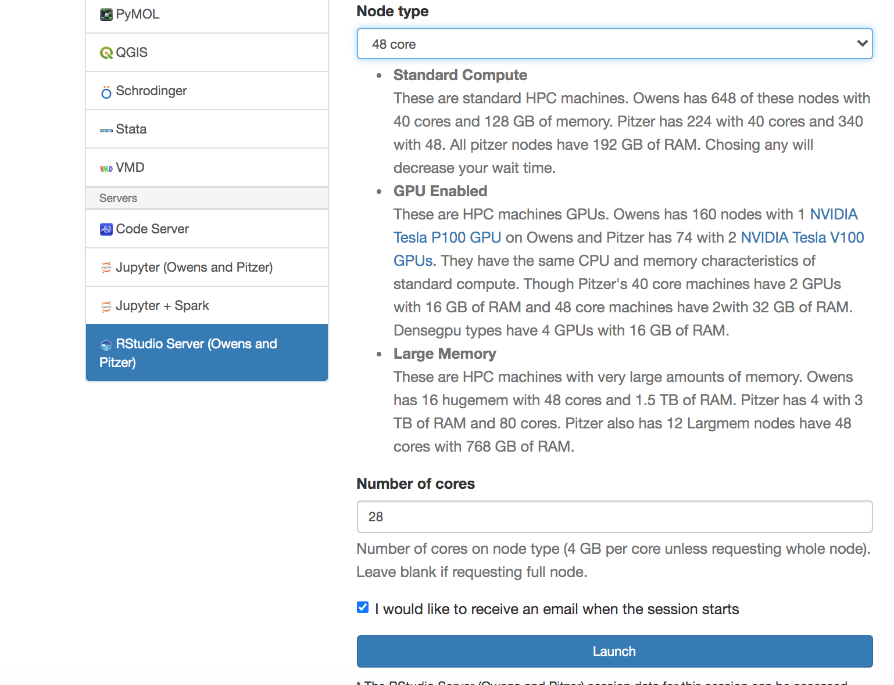
OSC OnDemand - Rstudio Server
123
Choose node type based on your need
Choose number of cores needed
1 core = 4GB RAM
Select larger node type if you request hundreds of RAMs

Slide 18
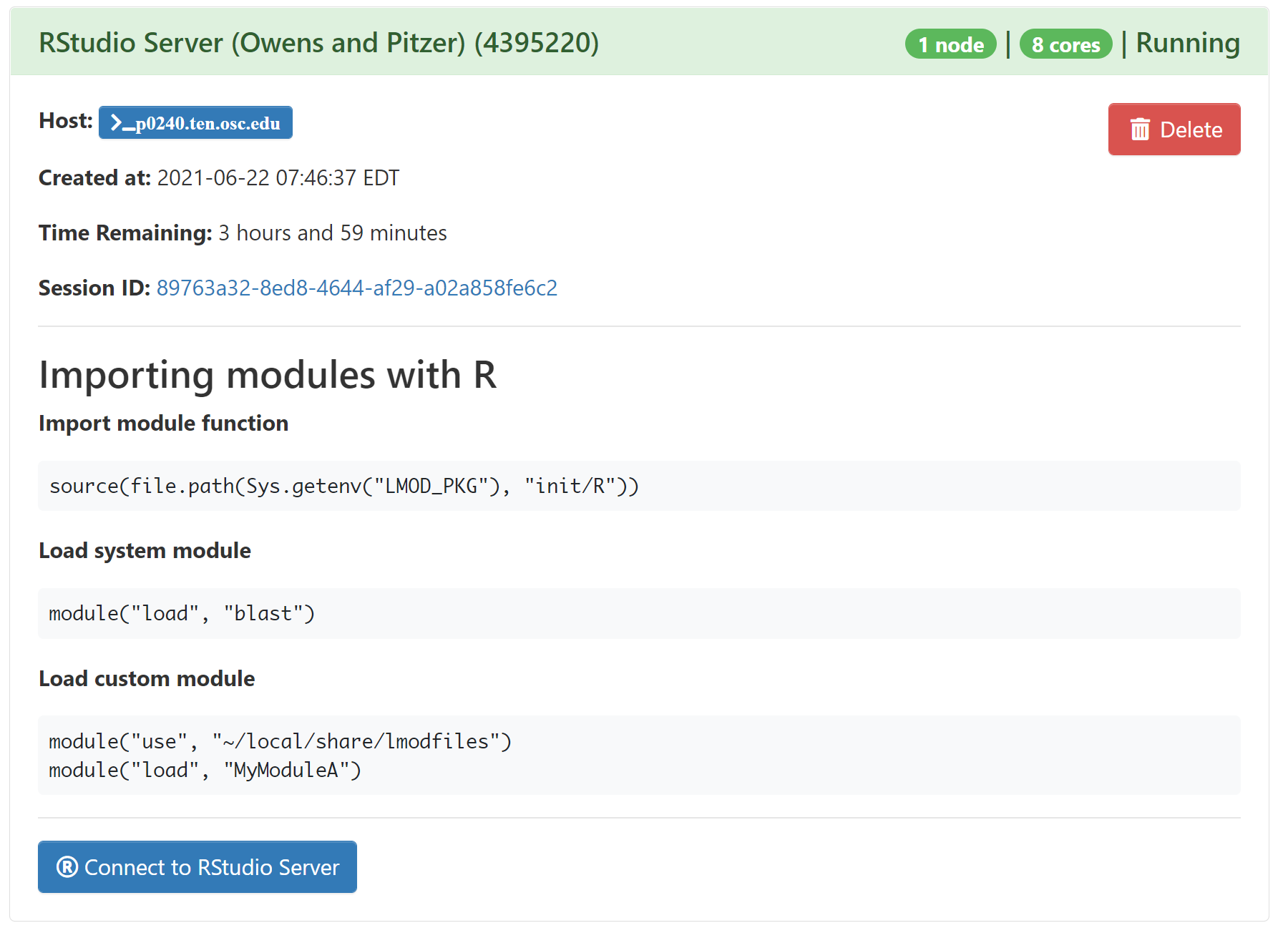
OSC OnDemand - Launching Rstudio Server
123

Slide 19
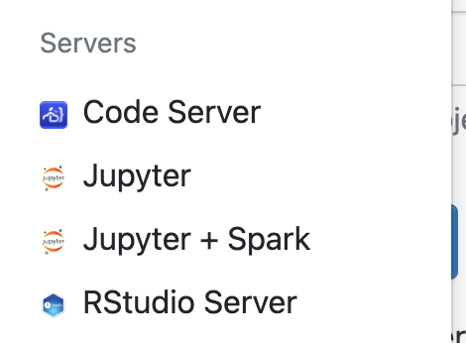
Other interactive apps
Visual studio code
Jupyter notebooks

Slide 20
BMBL projects
Admin: Cankun Wang
PCON0022: BMI department condo
25 TB total storage, 6 million files for all users
Use it for computing and storage
PAS1475
25 TB total storage, 1 million files for all users
Only use it for storage, NEVER use it for computing!!!
Notes:
Shared data folder tracking

Slide 21
Other ways to interact with OSC
SSH
ssh username@sftp.osc.edu
ssh username@pitzer.osc.edu
Transfer files
WinSCP (Windows)
FileZilla (MacOS)

Slide 22
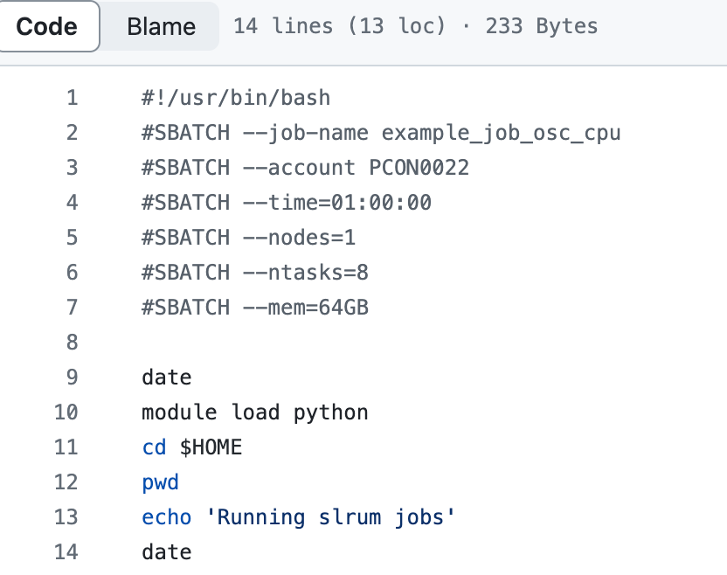
Example script for OSC
Filename: example_job_osc_cpu.sh
Submit job: sbatch example_job_osc_cpu.sh
Check jobs status: squeue -u <username>
Cancel a job: scancel <jobid>
https://github.com/Wang-Cankun/example_slurm_bmbl

Slide 23
How to start an interactive job?
Why?
By default, your login node only has 4GB RAM, but you want to run computing tasks interactively
OSC-CPU
salloc --nodes=1 --ntasks=8 --mem=64GB --account PCON0022 --time=2:00:00 srun --pty /bin/bash
OSC-GPU
salloc --nodes=1 --ntasks=8 --mem=64GB --account PCON0022 --gpus-per-node=1 --time=2:00:00 srun --pty /bin/bash
https://github.com/Wang-Cankun/example_slurm_bmbl

Slide 24
Change permission on OSC
-R mean apply to target folder and all sub directories
777 mean everyone can read/write/execute data in that folder
chmod –R 777 /path/to/folder
644 mean other people can read the files, but not able to delete & execute it
chmod –R 644 /path/to/folder

Slide 25
Example
1234

